Slide 1
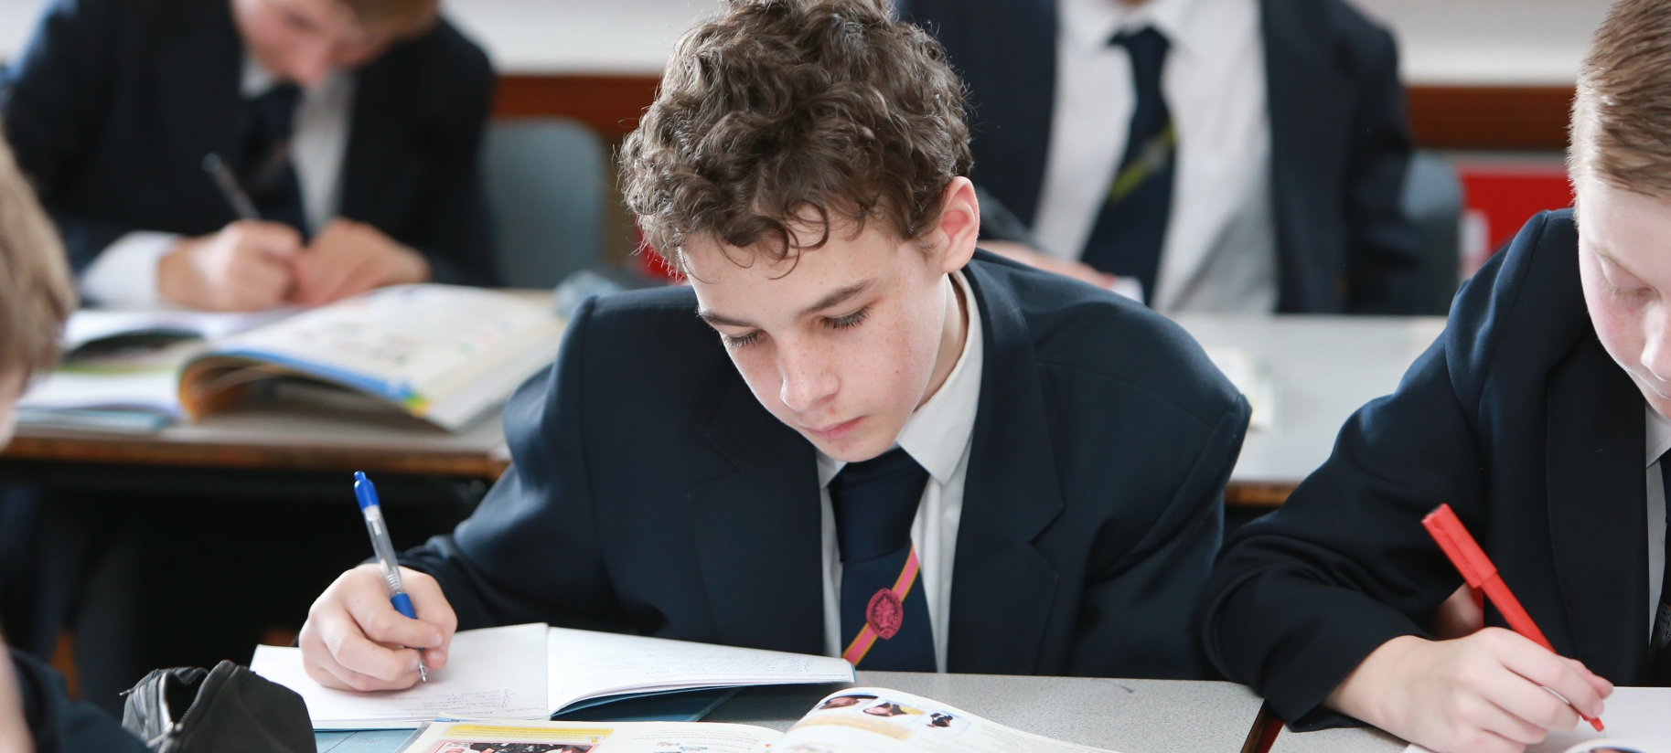
SPALDING GRAMMAR SCHOOL
Open Evening and11+ Information – 2026 ENTRY

Slide 2

Welcome
Mrs M Anderson Executive Headteacher
Mr S Evans Head of Year 7
Mrs A Johnson SENDCo
Mrs D Haslam School Administrator
School Planned Admission Number (PAN) 150
11+ qualifying mark (total combined minimum) 220
Spalding Grammar School operates its testing and admissions arrangements as part of the Lincolnshire Consortium of Grammar Schools (LCGS) and in conjunction with the Lincolnshire County Council co-ordinated admissions scheme.

Slide 3
Registration
Your child must be registered with us to sit the 11+ tests in September.
He must sit both papers and, to be eligible to be offered a Grammar School place, achieve a score of 220 or above.
The same tests are taken across the whole of Lincolnshire.
Please note – The test can only be taken once.
It is important that you inform us of any changes to personal information; address, telephone number, email during the admissions process.

Slide 4
The Structure of the Test
Two papers:
  Verbal Reasoning (VR)
  Non-Verbal Reasoning/Spatial Reasoning (NVR/SR)
Verbal Reasoning Test has 80 questions in 50 minutes
Non-Verbal Reasoning Test has 70 questions in 35 minutes
Each short test section (battery) has “warm up” questions
The total is therefore out of 150 (Raw Score)
The NVR/SR Familiarisation test is slightly longer (40mins)
The Familiarisation Test is for familiarisation only – structure of the questions not the same as real tests.

Slide 5
11+ Dates 2025 (for Sept 2026 entry)
Verbal Reasoning (VR)
  Friday, 12 September 2025 (OOC Schools)
  Saturday, 13 September 2025 (Lincs Schools)
Non-Verbal Reasoning (NVR)
  Friday, 19 September 2025 (OOC Schools)
  Saturday, 20 September 2025 (Lincs Schools)

Slide 6
Additional Needs
If your child has additional needs these should have been flagged on the registration form so that we can contact your child’s primary school for further information.
Any support your child needs should be his normal way of working in his primary school.
The School adheres to the Joint Council for Qualifications principles for access arrangements.

Slide 7
Illness
If your child is unwell on either of the test days and you believe it will affect his performance, please do not bring him.
Please email the School to let us know as soon as possible. It may not be possible to contact the School by phone on the test days.
Spalding Grammar School will offer a catch-up session for both tests around two weeks after the main tests.

Slide 8
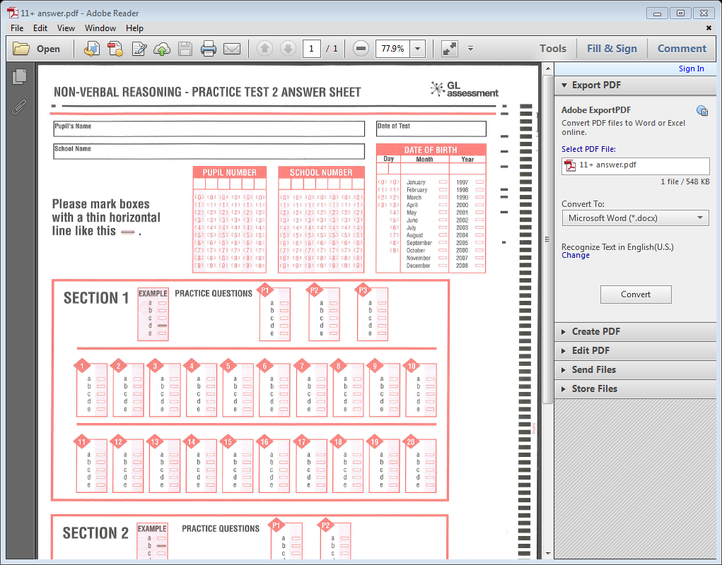
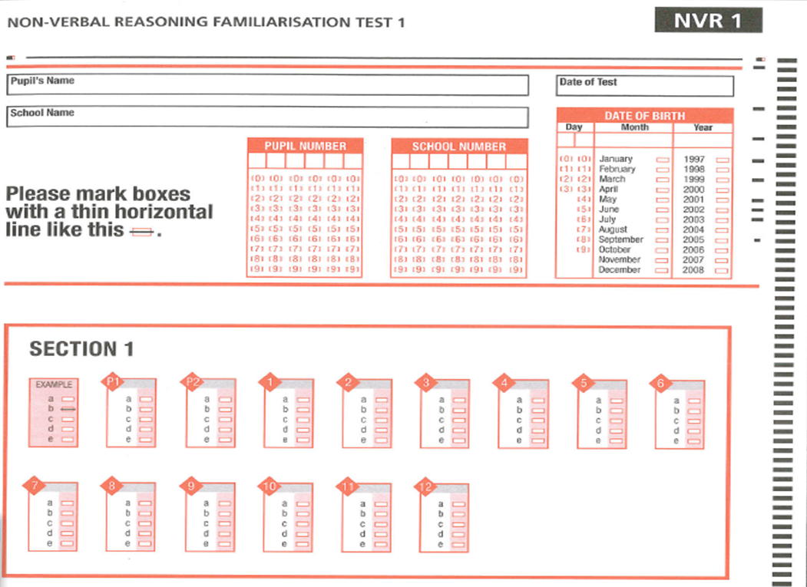
Answer Grid

Slide 9
Standardisation
GL Assessment mark and standardise all answer sheets for the LCGS
Raw Score out of 150 is “standardised” nationally on benchmarking set by the National Foundation for Educational Research (NFER).
Standardisation takes into account the actual age of the child at the time that the test was taken.
A child aged 10 years and 1 month (August baby) therefore is not disadvantaged by age compared with a September child of 11 years at the time of the test.

Slide 10
Preparation
As with most things over-coaching/over-training is not advised.
The tests are meant to be an indicator of natural intelligence.
How will a coached child cope in a highly academically demanding environment for 7 years?
Familiarisation – particularly timings.
More than a couple is of little proven benefit.
Familiarisation papers have been sent to our local feeder Primary Schools for them to administer at their discretion.
Out of county students have been invited to sit the practice papers at SGS Thursday 10 July.

Slide 11
Notification of Results & Offer Day
Notification of Results:
In the October following the tests, parents will receive a letter informing them if the qualifying mark of 220 has been achieved or not.
Parental Preference Form:
Lincolnshire County Council co-ordinate the parental preference forms in which parents rank their three preferred schools in order. Schools are not informed of the ranking position.
Offer Day:
National Offer Day is 2nd March.

Slide 12
SGS Oversubscription
Our PAN is 150 which is organised as five classes of 30.
Oversubscription criteria:
Children in care.
Distance.

Slide 13
Appeals process
If your child has not reached the qualifying score, you have the right to appeal, after 1 March 2026 when offers have been made. Information will be sent in the results notification letter.
Appeals are usually heard virtually, during May/June.
Spalding Grammar School must appear on your appeal application form.

Slide 14
Further Guidance
Local Authority Admissions Team and Website.
Primary School.
Q and A in the Main Hall after this presentation.
LCGS website.

Slide 15
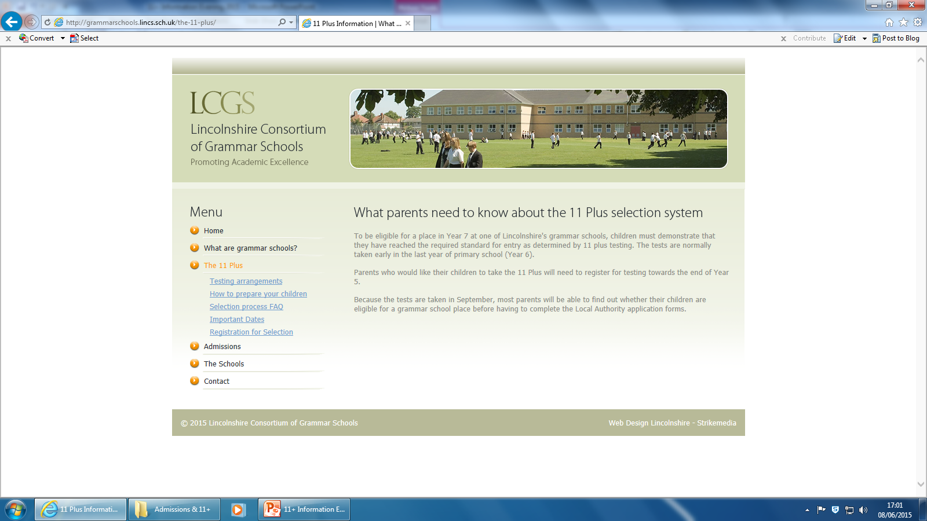
Lincolnshire Consortium

Slide 16
Thank you

