Slide 1


A Level Maths:: Summer Preparation
Powerpoint slides courtesy of Dr Frost maths
www.drfrostmaths.com
@DrFrostMaths

Slide 2
Contents
Rearranging formulae
Linear equations with fractions
Simplifying expressions
Expanding brackets
Simplifying Surds
Rationalising denominators
Factorising
Indices (1) and Indices (2)
Factorising quadratics
Solving quadratics (factorizing and use of formula)
Solving quadratics by completing the square
Algebraic fractions and quadratics
Linear simultaneous equations
One linear and one quadratic simultaneous equations
Solving simultaneous equations graphically

Slide 3
VIP GCSE Skills :: Rearranging formulae
Powerpoint slides courtesy of Dr Frost maths
www.drfrostmaths.com
@DrFrostMaths
Exercise 1

Slide 4



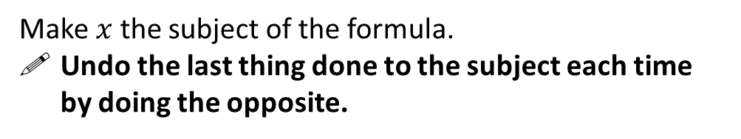
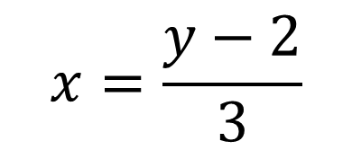

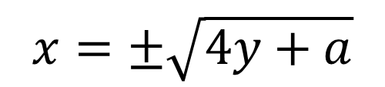

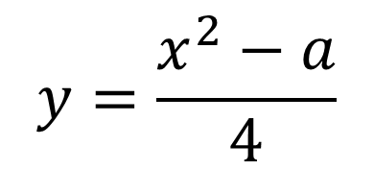
Basic Skill #1: ‘Undoing’ to Unlock
Exercise 1
Make $x$ the subject of the formula.
Undo the last thing done to the subject each time by doing the opposite.
Bro Tip: It doesn’t matter what side the subject is on, provided it’s on its own!
$$y=x−2$$
?
$$x=y+2$$
$$x=\frac{y−2}{3}$$
?
$$y=3x+2$$
?
$$y=\sqrt{x}+1$$
$$x={\left(y−1\right)}^{2}$$
$$y=\frac{x^{2}−a}{4}$$
$$x=±\sqrt{4y+a}$$
?

Slide 5





Basic Skill #2: Subject trapped in a negative term
When the subject is within the first argument of a subtraction, it’s easy to ‘release’.
$$2x=y+3$$
$$y=2x−3$$
?
However, it’s a tiny bit harder if the subject is in the term being subtracted.
When the subject is inside a negative term, just add it to both sides.
?
$$y=3−2x$$
$$y+2x=3$$
$$2x=3−y$$
?

Slide 6

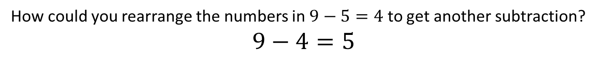
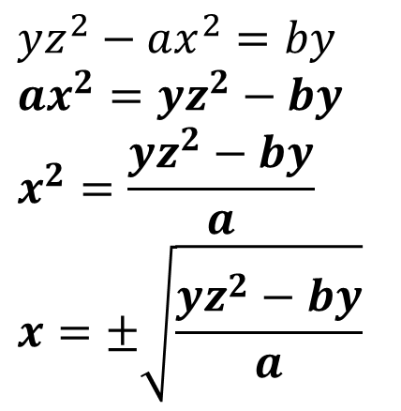
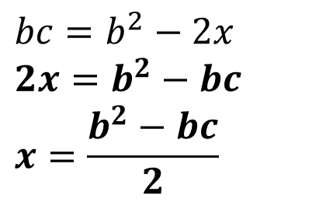
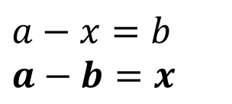
Doing it in one step… (if you like)
How could you rearrange the numbers in $9−5=4$ to get another subtraction?
$$9−4=5$$
?
This suggests you can swap the thing you’re subtracting with the result. (i.e. Only the thing to the left of the subtraction stays put)
Examples:
$$a−x=b \\ a−b=x$$
$$bc=b^{2}−2x \\ 2x=b^{2}−bc \\ x=\frac{b^{2}−bc}{2}$$
$$yz^{2}−ax^{2}=by \\ ax^{2}=yz^{2}−by \\ x^{2}=\frac{yz^{2}−by}{a} \\ x=±\sqrt{\frac{yz^{2}−by}{a}}$$
?
?
?

Slide 7
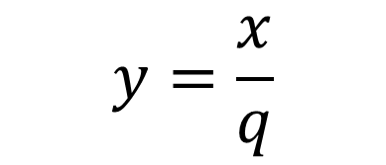
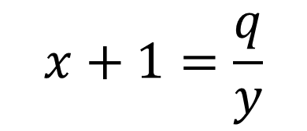
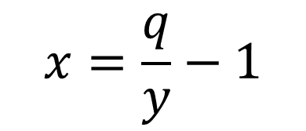

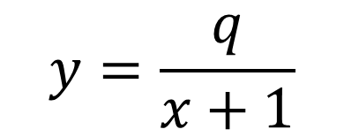

Basic Skill #3: Subject trapped in a denominator
When the subject is in the numerator of a fraction, it’s easy to ‘release’ the subject from the fraction.
$$y=\frac{x}{q}$$
?
$$x=qy$$
But it’s a bit harder if the subject is in the denominator…
In general, whenever you have a fraction in an equation, your instinct should be to multiply both sides by the denominator.
$$y=\frac{q}{x+1}$$
?
$$y\left(x+1\right)=q$$
$$x+1=\frac{q}{y}$$
?
$$x=\frac{q}{y}−1$$
?

Slide 8
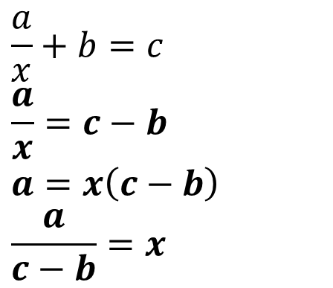
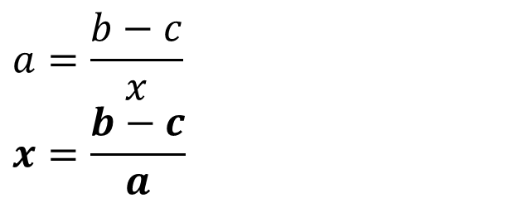
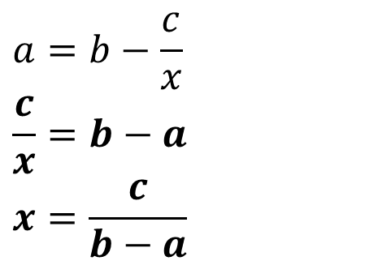
Basic Skill #3: Subject trapped in a denominator
! Isolate the fraction on one side of the equation, then multiply by denominator.
$$a=\frac{b−c}{x} \\ x=\frac{b−c}{a}$$
$$\frac{a}{x}+b=c \\ \frac{a}{x}=c−b \\ a=x\left(c−b\right) \\ \frac{a}{c−b}=x$$
1
2
?
?
$$a=b−\frac{c}{x} \\ \frac{c}{x}=b−a \\ x=\frac{c}{b−a}$$
3
?

Slide 9
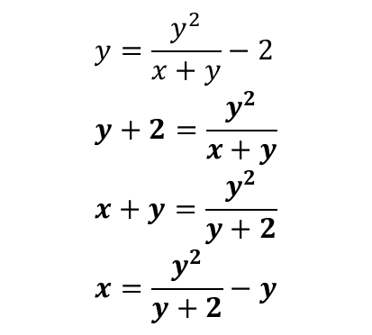
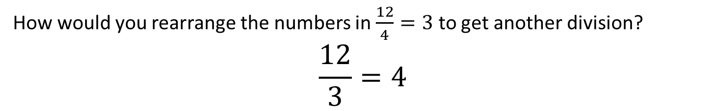
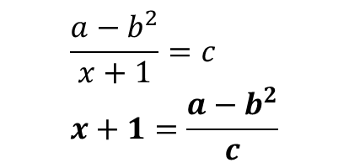
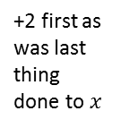
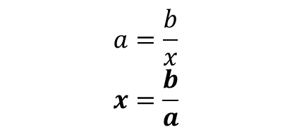
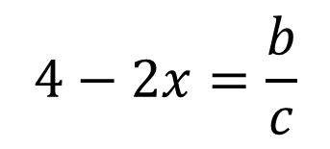
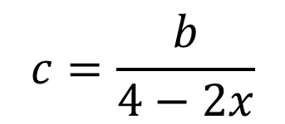
Doing it in one step… (if you like)
How would you rearrange the numbers in $\frac{12}{4}=3$ to get another division?
$$\frac{12}{3}=4$$
?
Thus we can swap the thing we’re dividing by and the result. The numerator is left unchanged.
?
$$c=\frac{b}{4−2x}$$
$$4−2x=\frac{b}{c}$$
Examples:
$$y=\frac{y^{2}}{x+y}−2 \\ y+2=\frac{y^{2}}{x+y} \\ x+y=\frac{y^{2}}{y+2} \\ x=\frac{y^{2}}{y+2}−y$$
E3
$$a=\frac{b}{x} \\ x=\frac{b}{a}$$
$$\frac{a−b^{2}}{x+1}=c \\ x+1=\frac{a−b^{2}}{c}$$
+2 first as was last thing done to $x$
E1
E2
?
?
?

Slide 10
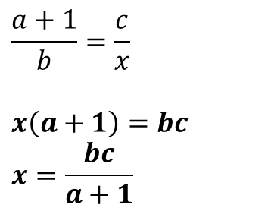
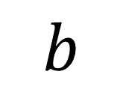

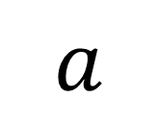
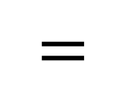
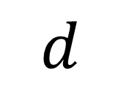
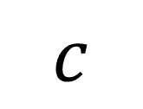
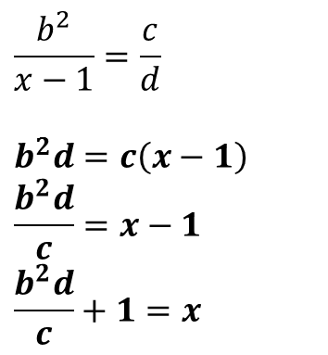
Skill #3b: ‘Cross multiplying’
If you have just a fraction on each side of the equation, you can ‘cross multiply’.
$$a$$
$$c$$
$$=$$
Click for Bromanimation
$$b$$
$$d$$
Examples:
Make $x$ the subject:
$$\frac{b^{2}}{x−1}=\frac{c}{d}$$
$$b^{2}d=c\left(x−1\right) \\ \frac{b^{2}d}{c}=x−1 \\ \frac{b^{2}d}{c}+1=x$$
$$\frac{a+1}{b}=\frac{c}{x}$$
$$x\left(a+1\right)=bc \\ x=\frac{bc}{a+1}$$
E2
E1
?
?

Slide 11
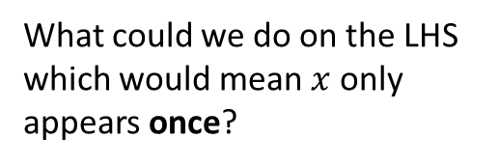

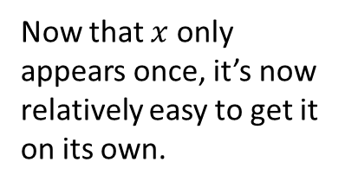
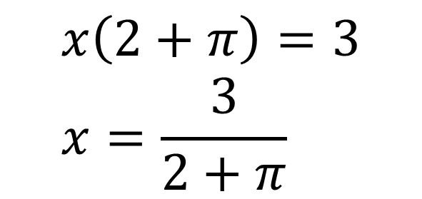
What if the subject appears multiple times?
Make $x$ the subject of:
$$2x+πx=3$$
What could we do on the LHS which would mean $x$ only appears once?
?
$$x\left(2+π\right)=3 \\ x=\frac{3}{2+π}$$
Now that $x$ only appears once, it’s now relatively easy to get it on its own.
?

Slide 12
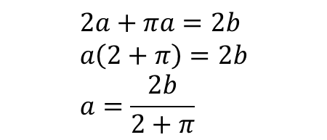
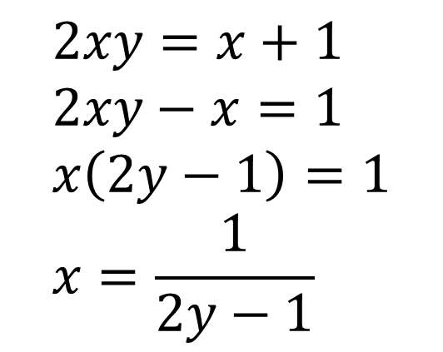
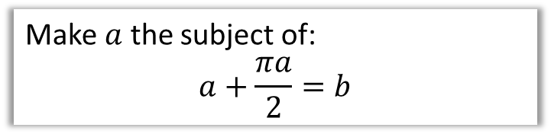
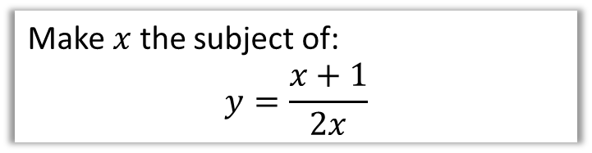
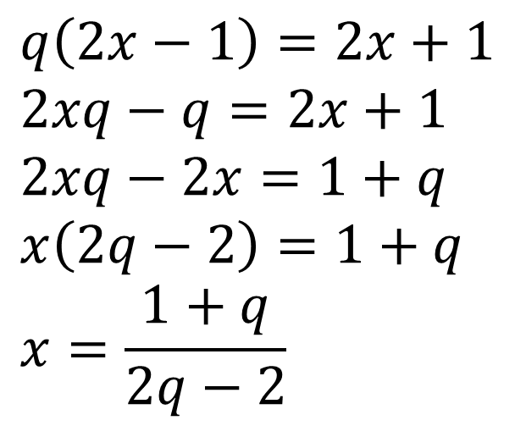
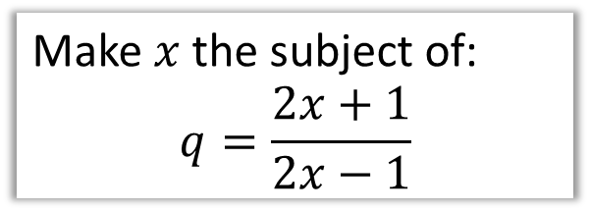
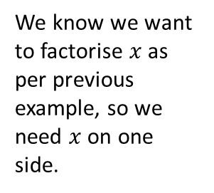
More examples
Make $x$ the subject of:
$$y=\frac{x+1}{2x}$$
Make $x$ the subject of:
$$q=\frac{2x+1}{2x−1}$$
We don’t like fractions in equations, so…
?
$$2xy=x+1 \\ 2xy−x=1 \\ x\left(2y−1\right)=1 \\ x=\frac{1}{2y−1}$$
?
?
We know we want to factorise $x$ as per previous example, so we need $x$ on one side.
$$q\left(2x−1\right)=2x+1 \\ 2xq−q=2x+1 \\ 2xq−2x=1+q \\ x\left(2q−2\right)=1+q \\ x=\frac{1+q}{2q−2}$$
?
?
Make $a$ the subject of:
$$a+\frac{πa}{2}=b$$
$$2a+πa=2b \\ a\left(2+π\right)=2b \\ a=\frac{2b}{2+π}$$
?

Slide 13
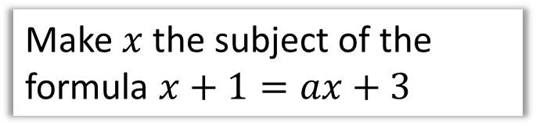
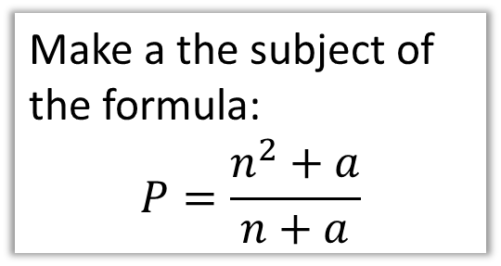
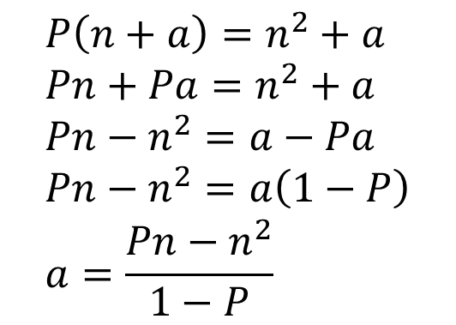
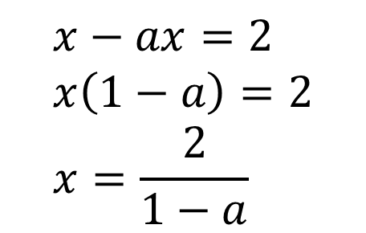
Test Your Understanding
Method Reminder:
Isolate subject on one side (and other terms of other side).
Factorise it.
Make $x$ the subject of the formula $x+1=ax+3$
Make a the subject of the formula:
$$P=\frac{n^{2}+a}{n+a}$$
$$x−ax=2 \\ x\left(1−a\right)=2 \\ x=\frac{2}{1−a}$$
?
Bro Note: According to the Examiner’s Report, only 5% of students got full marks to this question)
$$P\left(n+a\right)=n^{2}+a \\ Pn+Pa=n^{2}+a \\ Pn−n^{2}=a−Pa \\ Pn−n^{2}=a\left(1−P\right) \\ a=\frac{Pn−n^{2}}{1−P}$$
?

Slide 14
VIP GCSE Skills :: Algebraic fractions
Powerpoint slides courtesy of Dr Frost maths
www.drfrostmaths.com
@DrFrostMaths

Slide 15

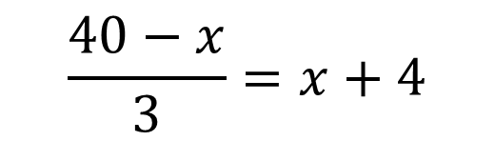



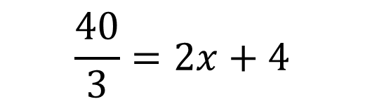
Starter
Exercise 2
Are these algebraic steps correct?
(Click your answer)
$$\frac{40−x}{3}=x+4$$
$$\frac{40}{3}=2x+4$$
✓
Fail
✗
Win!
$$2\left(4−2x\right)=3x−2$$
$$2\left(4\right)=5x−2$$
✓
Fail
✗
Win!
$$\sqrt{2−x}=2x+3$$
$$\sqrt{2}=3x+3$$
✓
Fail
✗
Win!
Notes:
Ask students why they think the step might have been made (in addition to pointing out why it’s incorrect!). Emphasise that when a term is contained within either a bracket, fraction or root, applying the reverse of the term to the whole expression doesn’t generally have the desired effect.

Slide 16
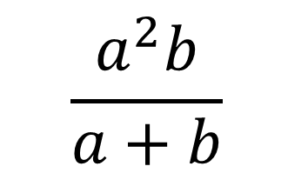
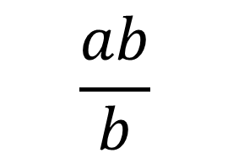
Starter
Are these algebraic steps correct?
(Click your answer)
$$\frac{a^{2}b}{a+b}$$
$$\frac{ab}{b}$$
✓
Fail
✗
Win!

Slide 17
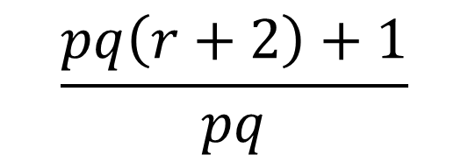
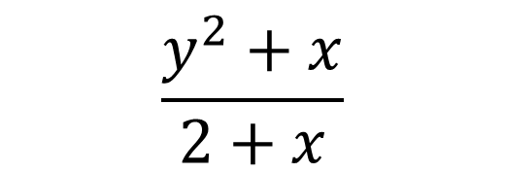
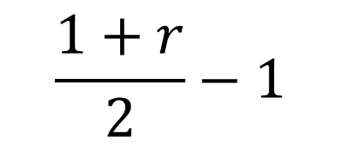



Starter
To cancel or not to cancel, that is the question?
(Click your answer)
$$\frac{y^{2}+x}{2+x}$$
$$\frac{s(4+z)}{s}$$
$$\sqrt{x^{2}+2}=y+2$$
✓
Fail
✗
Win!
✗
Fail
✓
Win!
✓
Fail
✗
Win!
$$\frac{(2x+1)(x−2)}{x−2}$$
$$\frac{pq\left(r+2\right)+1}{pq}$$
$$\frac{1+r}{2}−1$$
✗
Fail
✓
Win!
✓
Fail
✗
✓
Win!
Fail
✗
Win!

Slide 18



What did we learn?
Bro Tip #1: You can’t add or subtract a term which is ‘trapped’ inside a bracket, fraction or root.
$$2\sqrt{a−x}=2x+1$$
$→ 2\sqrt{a}=3x+1$ ☹
Bro Tip #2: In a fraction, we can only divide top and bottom by something, not add/subtract.
(e.g. $\frac{5}{7}$ is not the same as $\frac{6}{8}$!)
$\frac{a+b}{c+b} → \frac{a}{c}$ ☹

Slide 19





Simplifying Algebraic Fractions
Bro Tip: Just factorise top and bottom, then cancel!
$$\frac{x^{2}+x}{x+1}=\frac{x\left(x+1\right)}{x+1}=x$$
?
Bro Note: Do NOT leave your answer as $\frac{x}{1}$!
?
$$\frac{2x^{2}+4x}{x^{2}−4}=\frac{2x\left(x+2\right)}{\left(x+2\right)\left(x−2\right)}=\frac{2x}{x−2}$$
$$\frac{3x+3}{x^{2}+3x+2}=\frac{3}{x+2}$$
?
$$\frac{2x^{2}−5x−3}{6x^{3}−2x^{4}}=−\frac{2x+1}{2x^{3}}$$
?

Slide 20

Test Your Understanding
Bro Tip: Sometimes they’ve done part of the factorising for you!
$$\frac{x(x+1)}{x^{2}−1}→\frac{x}{x−1}$$
$$\frac{2x^{2}+5x−3}{x^{2}−9}→\frac{2x−1}{x−3}$$
$$\frac{x^{2}+2xy+y^{2}}{2x+2y}→\frac{x+y}{2}$$
?
?
?

Slide 21

Negating a difference
$$−\left(4−y\right)=y−4$$
$$−\left(2x−9\right)=9−2x$$
$$\frac{1−x}{x−1}=−1$$
$$\frac{\left(3−2x\right)\left(2−x\right)}{\left(2x−3\right)\left(x+1\right)}=\frac{x−2}{x+1}$$
?
?
?
?

Slide 22





Adding/Subtracting Fractions
What’s our usual approach for adding fractions?
Since denominator of first fraction got multiplied by 2, so must numerator. We can say we are “cross multiplying the numerators”.
$$\frac{2}{3}+\frac{1}{2}=\frac{4+3}{6}=\frac{7}{6}$$
?
We can get a common denominator by just multiplying the denominators.
Bro Tip: There’s a good reason why I’m writing as a single fraction $\frac{4+3}{6}$ immediately rather than initially as two separate fractions $\frac{4}{6}+\frac{3}{6}$. It’ll avoid sign problems when we come to subtracting algebraic fractions.
Quickfire Questions:
?
?
?
$$\frac{2}{5}+\frac{5}{6}=\frac{12+25}{30}=\frac{27}{30}$$
$$\frac{6}{7}−\frac{2}{3}=\frac{18−14}{21}=\frac{4}{21}$$
$$\frac{5}{8}+\frac{3}{5}=\frac{25−24}{40}=\frac{1}{40}$$

Slide 23

Adding/Subtracting Fractions
Sometimes we don’t need to multiply the denominators. We can find the Lowest Common Multiple of the denominators.
?
?
$$\frac{1}{3}+\frac{1}{9}=\frac{3}{9}+\frac{1}{9}=\frac{4}{9}$$
The technique (of NOT just blindly multiplying the denominators) will become important for harder algebraic fraction questions.

Slide 24





Adding/Subtracting Algebraic Fractions
The same principle can be applied to algebraic fractions.
!
?
$$\frac{x}{3}+\frac{2x+1}{2}=\frac{2x+3\left(2x+1\right)}{6}=\frac{8x+3}{6}$$
?
$$\frac{x+1}{2}−\frac{x−1}{3}=\frac{3\left(x+1\right)−2(x−1)}{6}=\frac{8x+3}{6}$$
Bro Note: Bracketing here is important to avoid sign errors. Note that $−2×−1=+2$, i.e. positive!
?
Bro Tip: Notice that with this one, we didn’t need to times $x$ and $x^{2}$ together: $x^{2}$ is a multiple of both denominators.

Slide 25

Further Example
?
$$\frac{3}{x−1}−\frac{4}{x}=\frac{3x−4\left(x−1\right)}{x\left(x−1\right)} \\ =\frac{3x−4x+4}{x\left(x−1\right)} \\ =\frac{−x+4}{x\left(x−1\right)}$$
?
?
Bro Tip: Be careful with your negatives!
Bro Tip: The numerator needn’t be expanded out because it is factorised – you get the marks either way.

Slide 26






Test Your Understanding
?
$$\frac{2}{x+1}+\frac{3}{x−1}=\frac{5x+1}{\left(x+1\right)\left(x−1\right)}$$
?
?
?
?
$$\frac{2}{x−2}−\frac{x}{x+1}=\frac{2−x^{2}+4x}{\left(x−2\right)\left(x+1\right)}$$
“To learn secret way of ninja, add or subtract fractions you must.”

Slide 27



Multiplying and Dividing
?
$$\frac{1}{x}×\frac{x^{2}}{2}=\frac{x^{2}}{2x}=\frac{x}{2} \\ \frac{1}{x}÷\frac{x^{2}}{2}=\frac{1}{x}×\frac{2}{x^{2}}=\frac{2}{x^{3}}$$
$$\frac{x^{2}−x}{2xy}×\frac{4x^{2}}{x−1}=\frac{x\left(x−1\right)}{2xy}×\frac{4x^{2}}{x−1} \\ =\frac{x−1}{2y}×\frac{4x^{2}}{x−1}=\frac{4x^{2}\left(x−1\right)}{2y\left(x−1\right)}=\frac{2x^{2}}{y}$$
?
?
AQA Set 1 Paper 1 Q10
Bro Tip: Just factorise first.
$$=\frac{\left(3x−7\right)\left(x+2\right)}{\left(3x+2\right)\left(3x−2\right)}÷\frac{x+2}{x\left(3x+2\right)} \\ =\frac{\left(3x−7\right)\left(x+2\right)}{\left(3x+2\right)\left(3x−2\right)}×\frac{x\left(3x+2\right)}{x+2}=\frac{x\left(3x−7\right)}{3x−2}$$
?

Slide 28


Test Your Understanding
?
1
$$\frac{x^{2}+4x}{x^{2}−1}÷\frac{x+4}{x+1}=\frac{x\left(x+4\right)}{\left(x+1\right)\left(x−1\right)}×\frac{x+1}{x+4} \\ =\frac{x}{x−1}$$
?
2
$$\frac{2x^{2}−x−6}{16x^{2}−25}÷\frac{x−2}{4x^{2}−5x}=\frac{\left(2x+3\right)\left(x−2\right)}{\left(4x+5\right)\left(4x−5\right)}÷\frac{x−2}{x\left(4x−5\right)} \\ =\frac{\left(2x+3\right)\left(x−2\right)}{\left(4x+5\right)\left(4x−5\right)}×\frac{x\left(4x−5\right)}{x−2} \\ =\frac{x\left(2x+3\right)}{4x+5}$$

Slide 29



Solving Equations with Algebraic Fractions
Exercise 14
Bro Tip: In general, whenever you have fractions in an equation, your intuition should be “multiply through by the denominator”.
When asked to solve an equation with fractions:
Combine fractions into single fraction then multiply through by denominator.
But if multiplying everything by $x^{2}$ turns equation into a quadratic, this is simpler.
$$\frac{x}{2x−3}+\frac{4}{x+1}=1 \\ \frac{x^{2}+9x−12}{\left(2x−3\right)\left(x+1\right)}=1$$
$$x^{2}+9x−12=\left(2x−3\right)\left(x+1\right) \\ x^{2}+9x−12=2x^{2}−x−3 \\ x^{2}−10x+9=0 \\ \left(x−1\right)\left(x−9\right)=0 \\ x=1 or x=9$$
$$\frac{8}{x^{2}}+\frac{4}{x}=4 \\ 8+4x=4x^{2} \\ 2+x=x^{2} \\ x^{2}−x−2=0 \\ \left(x+1\right)\left(x−2\right)=0 \\ x=−1 or x=2$$
?
?

Slide 30




Test Your Understanding
$$\frac{x}{3}+\frac{10}{x−1}=4$$
$$x^{2}−13x+42=0 \\ \left(x−6\right)\left(x−7\right)=0 \\ x=6 or x=7$$
Solve, giving your answer to 3sf.
$$\frac{1}{x}+5=\frac{2}{x^{2}}$$
$$x+5x^{2}=2 \\ 5x^{2}+x−2 \\ x=−0.740 or x=0.540$$
?
?
$$\frac{4x−1}{5}+\frac{x+4}{2}=3$$
$$x=\frac{12}{13}$$
?
$$x=\frac{−b±\sqrt{b^{2}−4ac}}{2a}$$

Slide 31
AS Pure Chapter 1 :: Algebraic Techniques
Powerpoint slides courtesy of Dr Frost maths
www.drfrostmaths.com
@DrFrostMaths
Exercises 3 - 9

Slide 32






Chapter Overview
As a relatively gentle introduction to Pure, most of this chapter is a recap of core GCSE algebraic skills.
1:: Basic Index Laws
2:: Expand brackets
Simplify
$$\frac{3x^{2}−6x^{5}}{2x}$$
Expand and simplify
$${\left(x−3\right)}^{2}\left(x+1\right)$$
4:: Fractional/Negative Powers
3:: Factorise quadratics/cubics
Evaluate:
$${\left(\frac{27}{8}\right)}^{−\frac{2}{3}}$$
Factorise fully:
$$x^{3}−16x$$
NEW! (since GCSE)
You may have to combine factorisation techniques to factorise cubics.
5:: Surds
Rationalise the denominator of
$$\frac{1}{3+\sqrt{2}}$$
NEW! (since GCSE)
You’ve dealt with expressions of the form $\frac{a}{\sqrt{b}}$, but not with more complex denominators such as $\frac{a}{b−\sqrt{c}}$

Slide 33












1 :: Index Laws
Exercises 3 & 9
exponent or index (plural: indices)
base
!
$$a^{m}×a^{n}=a^{m+n} \\ a^{m}÷a^{n}=a^{m−n} \\ {\left(a^{m}\right)}^{n}=a^{mn} \\ {\left(ab\right)}^{n}=a^{n}b^{n}$$
$$3^{5}$$
power
Some also refer to the 5 as the ‘power’. But this would lead to unfortunate ambiguous phrases like “when we multiply two powers together, we add the powers” instead of “when we multiply two powers together, we add the indices”.
Simplify ${\left(a^{3}\right)}^{2}×2a^{2}$
Simplify ${\left(4x^{3}y\right)}^{3}$
?
?
$$=a^{6}×2a^{2}=2a^{8}$$
$$=64x^{9}y^{3}$$
Simplify $2x^{2}\left(3+5x\right)−x\left(4−x^{2}\right)$
Simplify $\frac{x^{3}−2x}{3x^{2}}$
?
?
$$=6x^{2}+10x^{3}−4x+x^{3} \\ =11x^{3}+6x^{2}−4x$$
$$=\frac{x^{3}}{{3x}^{2}}−\frac{2x}{3x^{2}} \\ =\frac{1}{3}x−\frac{2}{3x}$$
Fro Tip: A common student error is to get the sign wrong of $+x^{3}$
Fro Tip: While $\frac{a+b}{c}$ can be split into $\frac{a}{c}+\frac{b}{c}$, a common student error is to think that $\frac{a}{b+c}=\frac{a}{b}+\frac{a}{c}$

Slide 34









Test Your Understanding
1
Simplify ${\left(\frac{2a^{5}}{a^{2}}\right)}^{2}×3a$
2
Simplify $\frac{2x+x^{5}}{4x^{3}}$
?
?
$$={\left(2a^{3}\right)}^{2}×3a \\ =4a^{6}×3a \\ =12a^{7}$$
$$=\frac{1}{2}x^{−2}+\frac{1}{4}x^{2}$$
or $\frac{1}{2x^{2}}+\frac{x^{2}}{4}$
3
Expand and simplify
$$2x\left(3−x^{2}\right)−4x^{3}\left(3−x\right)$$
4
Simplify $2^{x}×3^{x}$
?
$$=6^{x}$$
Fro Note: This is using ${\left(ab\right)}^{n}=a^{n}b^{n}$ law backwards.
?
$$=6x−2x^{3}−12x^{3}+4x^{4} \\ =4x^{4}−14x^{3}+6x$$

Slide 35









2 :: Expanding Brackets
Exercise 4
If you have ever been taught ‘FOIL’ to multiply brackets please purge it from your mind now – instead:
Multiply each term in the first bracket by each term in the second.
$$\left(x−y\right)\left(x+y−1\right)$$
Fro Tip: My order is “first term in first brackets times each in second, then second term in first bracket times each in second, etc.”
$$=x^{2}$$
$$+xy$$
$$−x$$
$$−xy$$
$$−y^{2}$$
$$+y$$
$$=x^{2}−y^{2}−x+y$$
Fro Tip: For more than 2 brackets, multiply two out each time to reduce the number of brackets by one.
$$\left(x+1\right)\left(x+2\right)\left(x+3\right) \\ =\left(x+1\right)\left(x^{2}+5x+6\right) \\ =x^{3}+5x^{2}+6x+x^{2}+5x+6 \\ =x^{3}+6x^{2}+11x+6$$
?

Slide 36






Test Your Understanding
1
Expand and simplify
$$\left(x+5\right)\left(x−2\right)\left(x+1\right)$$
2
Expand and simplify:
$$2\left(x−3\right)\left(x−4\right)$$
?
?
$$=\left(x+5\right)\left(x^{2}−x−2\right) \\ =x^{3}−x^{2}−2x+5x^{2}−5x−10 \\ =x^{3}+4x^{2}−7x−10$$
$$=2\left(x^{2}−7x+12\right) \\ =2x^{2}−14x+24$$
3
Expand and simplify:
$${\left(2x−1\right)}^{3}$$
?
$$=\left(2x−1\right)\left(2x−1\right)\left(2x−1\right) \\ =\left(2x−1\right)\left(4x^{2}−4x+1\right) \\ =8x^{3}−8x^{2}+2x−4x^{2}+4x−1 \\ =8x^{3}−12x^{2}+6x−1$$

Slide 37





3 :: Factorising
Exercise 8
Informally, factorising is the opposite of expanding brackets.
More formally, a factorised expression is one which is expressed as a product of expressions.
$$x(x+1)(x+2)$$
Factorised as it is the product of 3 linear factors, $x, x+1$ and $x+2$.
Fro Note: A linear expression is of the form $ax+b$. It is called linear because plotting $y=ax+b$ would form a straight line.
$$x\left(x+1\right)+\left(x−1\right)\left(x+1\right)$$
Not factorised because the outer-most operation is a sum, not a product.
Basic Examples:
?
$$x^{3}+x^{2} =x^{2}\left(x+1\right) \\ 4x−8xy=4x\left(1−2y\right)$$
?

Slide 38







Factorising Quadratics
Exercise 10
Recap:
We find two numbers which multiply to give the coefficient of $x$ and multiply to give the constant term.
$$⊕$$
$$⊗$$
?
$$x^{2}−5x−14=\left(x−7\right)\left(x+2\right)$$
Fro Note: The coefficient of a term is the constant on front of it, e.g. the coefficient of $4x^{2}$ is 4.
But what if the coefficient of $x^{2}$ is not 1?
$${2x}^{2}+5x−12=\left(2x−3\right)\left(x+4\right)$$
?
The easiest way is to use your common sense to guess the brackets. What multiplies to give the $2x^{2}$? What multiplies to give the constant term of $−12$?
?
Or you can ‘split the middle term’ (don’t be embarrassed if you’ve forgotten how to!)
$$⊕5 \\ ⊗−24$$
$${2x}^{2}+5x−12 \\ =2x^{2}+8x−3x−12 \\ =2x\left(x+4\right)−3\left(x+4\right) \\ =(x+4)(2x−3)$$
?
STEP 1: Find two numbers which add to give the middle number and multiply to give the first times last.
?
STEP 2: Split the middle term.
?
STEP 3: Factorise first half and second half ensuring bracket is duplicated..
?
STEP 4: Factorise out bracket.

Slide 39


Other Factorisations
Difference of two squares:
?
$$4x^{2}−9=\left(2x+3\right)\left(2x−3\right)$$
Using multiple factorisations:
$$x^{3}−x \\ =x\left(x^{2}−1\right) \\ =x(x+1)(x−1)$$
Fro Tip: Always look for a common factor first before using other factorisation techniques.
?
$$x^{3}+3x^{2}+2x \\ =x\left(x^{2}+3x+2\right) \\ =x\left(x+2\right)\left(x+1\right)$$
?

Slide 40









Test Your Understanding
1
Factorise completely:
$$6x^{2}+x−2$$
2
Factorise completely:
$$x^{3}−7x^{2}+12x$$
$$6x^{2}+x−2 ⊕1 ⊗−12 \\ =6x^{2}+4x−3x−2 \\ =2x\left(3x+2\right)−1\left(3x+2\right) \\ =\left(3x+2\right)\left(2x−1\right)$$
$$=x\left(x^{2}−7x+12\right) \\ =x\left(x−3\right)\left(x−4\right)$$
?
?
N
Factorise completely:
$$x^{4}−1$$
N
Factorise completely:
$$x^{3}−1$$
?
?
$$=\left(x^{2}+1\right)\left(x^{2}−1\right) \\ =\left(x^{2}+1\right)\left(x+1\right)\left(x−1\right)$$
$$=(x−1)(x^{2}+x+1)$$
Fro Note: You would not be expected to factorise this at A Level (but you would in STEP!).
In general, the difference of two cubes:
$$x^{3}−y^{3}=\left(x−y\right)\left(x^{2}+xy+y^{2}\right)$$

Slide 41














4 :: Negative and Fractional Indices
Exercise 9
$$a^{0}=1 \\ a^{\frac{1}{m}}=\sqrt[m]{a} \\ a^{\frac{n}{m}}={\left(\sqrt[m]{a}\right)}^{n} \\ a^{−m}=\frac{1}{a^{m}}$$
Fro Note: $\sqrt{9}$ only means the positive square root of 9, i.e. 3 not -3.
Otherwise, what would be the point of the $±$ in the quadratic formula before the $\sqrt{b^{2}−4ac}$?
Prove that $x^{\frac{1}{2}}=\sqrt{x}$
Evaluate ${27}^{−\frac{1}{3}}$
Evaluate ${32}^{\frac{2}{5}}$
?
?
?
$$x^{\frac{1}{2}}×x^{\frac{1}{2}}=x^{1}$$
But $\sqrt{x}×\sqrt{x}=x$
$$∴x^{\frac{1}{2}}=\sqrt{x}$$
$$=\frac{1}{{27}^{\frac{1}{3}}}=\frac{1}{3}$$
$$=2^{2}=4$$
Simplify ${\left(\frac{1}{9}x^{6}y\right)}^{\frac{1}{2}}$
Evaluate ${\left(\frac{27}{8}\right)}^{−\frac{2}{3}}$
If $b=\frac{1}{9}a^{2}$, determine $3b^{−2}$ in the form $kb^{n}$ where $k,n$ are constants.
?
$$={\left(\frac{8}{27}\right)}^{\frac{2}{3}}={\left(\frac{2}{3}\right)}^{2}=\frac{4}{9}$$
$$=\frac{1}{3}x^{3}y^{\frac{1}{2}}$$
?
?
$$3b^{−2}=3{\left(\frac{1}{9}a^{2}\right)}^{−2} \\ =3\left(81a^{−4}\right)=243a^{−4}$$

Slide 42



Writing a surd using indices
If $9\sqrt{3}=3^{k}$, determine the value of $k$.
The key here is to write everything as powers with a consistent base, in this case, 3.
?
$$9\sqrt{3}=9×\sqrt{3} \\ =3^{2}×3^{\frac{1}{2}} \\ =3^{\frac{5}{2}}$$
$$∴k=\frac{5}{2}$$
Fro Note: In algebra we like to avoid mixed numbers. So don’t write $3^{2\frac{1}{2} }$

Slide 43




Further Examples
[Edexcel IGCSE May14-4H] Given that
$${\left(2^{\frac{1}{2}}\right)}^{n}=\frac{2^{x}}{8^{y}}$$
Express $n$ in terms of $x$ and $y$.
[Edexcel IAL C12 Jan 2019 Q2c] Given that $y=2^{x}$, express the following in terms of $y$.
$$\frac{1}{4^{2x−3}}$$
Write your expression in its simplest form.
?
?
$$2^{\frac{1}{2}n}=\frac{2^{x}}{{\left(2^{3}\right)}^{y}} \\ =\frac{2^{x}}{2^{3y}}=2^{x−3y} \\ ∴\frac{1}{2}n=x−3y \\ n=2x−6y$$
$$\frac{1}{4^{2x−3}}=4^{−(2x−3)}=4^{−2x+3} \\ ={\left(2^{2}\right)}^{−2x+3} \\ =2^{−4x+6} \\ =2^{−4x}×2^{6} \\ ={\left(2^{x}\right)}^{−4}×64 \\ =64y^{−4} or \frac{64}{y^{4}}$$
Write 8 as a power of 2 (putting a bracket around it), for consistency of base with the other powers.

Slide 44


Test Your Understanding
Edexcel Paper 2 – May 2019
?

Slide 45



5 :: Surds
Exercises 5-7
Recap:
Fro Note: A rational number is any which can be expressed as $\frac{a}{b}$ where $a,b$ are integers. $\frac{2}{3}$ and $\frac{4}{1}=4$ are rational numbers, but $π$ and $\sqrt{2}$ are not.
A surd is a root of a number that does not simplify to a rational number.
Laws:
$$\sqrt{a}×\sqrt{b}=\sqrt{ab} \\ \frac{\sqrt{a}}{\sqrt{b}}=\sqrt{\frac{a}{b}}$$
?
$$\sqrt{3}×2 =2\sqrt{3} \\ 3\sqrt{5}×2\sqrt{5} =30 \\ \sqrt{8}=\sqrt{4}\sqrt{2} =2\sqrt{2} \\ \sqrt{12}+\sqrt{27} =2\sqrt{3}+3\sqrt{3}=5\sqrt{3} \\ \left(\sqrt{8}+1\right)\left(\sqrt{2}−3\right) =\sqrt{16}−3\sqrt{8}+\sqrt{2}−3 \\ =4−6\sqrt{2}+\sqrt{2}−3 \\ =1−5\sqrt{2}$$
?
?
?
?
?
?

Slide 46


6 :: Rationalising The Denominator
Here’s a surd. What could we multiply it by such that it’s no longer an irrational number?
?
?
$$\sqrt{5}×\sqrt{5}=5$$
$$\frac{1}{\sqrt{2}}×\frac{\sqrt{2}}{\sqrt{2}}=\frac{\sqrt{2}}{2}$$
?
?
In this fraction, the denominator is irrational. ‘Rationalising the denominator’ means making the denominator a rational number.
What could we multiply this fraction by to both rationalise the denominator, but leave the value of the fraction unchanged?
Bro Side Note: There’s two reasons why we might want to do this:
For aesthetic reasons, it makes more sense to say “half of root 2” rather than “one root two-th of 1”. It’s nice to divide by something whole!
It makes it easier for us to add expressions involving surds.

Slide 47


Examples
$$\frac{3}{\sqrt{2}}=\frac{3\sqrt{2}}{2}$$
$$\frac{6}{\sqrt{3}}=\frac{6\sqrt{3}}{3}=2\sqrt{3}$$
$$\frac{7}{\sqrt{7}}=\frac{7\sqrt{7}}{7}=\sqrt{7}$$
$$\frac{15}{\sqrt{5}}+\sqrt{5}=3\sqrt{5}+\sqrt{5}=4\sqrt{5}$$
Test Your Understanding:
?
?
$$\frac{12}{\sqrt{3}}=4\sqrt{3}$$
$$\frac{2}{\sqrt{6}}=\frac{\sqrt{6}}{3}$$
$$\frac{4\sqrt{2}}{\sqrt{8}}=\frac{16}{8}=2$$
?
?
?
?
?

Slide 48


More Complex Denominators
You’ve seen ‘rationalising a denominator’, the idea being that we don’t like to divide things by an irrational number.
But what do we multiply the top and bottom by if we have a more complicated denominator?
$$\frac{1}{\sqrt{2}+1}×\frac{\sqrt{2}−1}{\sqrt{2}−1}=\frac{\sqrt{2}−1}{1}=\sqrt{2}−1$$
?
?
We basically use the same expression but with the sign reversed (this is known as the conjugate). That way, we obtain the difference of two squares. Since $\left(a+b\right)\left(a−b\right)=a^{2}−b^{2}$, any surds will be squared and thus we’ll end up with no surds in the denominator.

Slide 49




More Examples
$$\frac{3}{\sqrt{6}−2}×\frac{\sqrt{6}+2}{\sqrt{6}+2}=\frac{3\sqrt{6}+6}{2}$$
You can explicitly expand out $\left(\sqrt{6}−2\right)\left(\sqrt{6}+2\right)$ in the denominator, but remember that $\left(a−b\right)\left(a+b\right)=a^{2}−b^{2}$ so we can mentally obtain $6−4=2$
Just remember: ‘difference of two squares’!
?
?
$$\frac{4}{\sqrt{3}+1}×\frac{\sqrt{3}−1}{\sqrt{3}−1}=\frac{4\sqrt{3}−4}{2}=2\sqrt{3}−2$$
?
?
?
?
?
$$\frac{3\sqrt{2}+4}{5\sqrt{2}−7}×\frac{5\sqrt{2}+7}{5\sqrt{2}+7}=\frac{30+21\sqrt{2}+20\sqrt{2}+28}{1} \\ =58+41\sqrt{2}$$

Slide 50






Test Your Understanding
Rationalise the denominator and simplify
$$\frac{4}{\sqrt{5}−2}$$
?
$$8+4\sqrt{5}$$
Rationalise the denominator and simplify
$$\frac{2\sqrt{3}−1}{3\sqrt{3}+1}$$
AQA IGCSE FM June 2013 Paper 1
Solve $y\left(\sqrt{3}−1\right)=8$
Give your answer in the form $a+b\sqrt{3}$ where $a$ and $b$ are integers.
?
$$\frac{2\sqrt{3}−1}{3\sqrt{3}+1}×\frac{3\sqrt{3}−1}{3\sqrt{3}−1} \\ =\frac{18−2\sqrt{3}−3\sqrt{3}+1}{27−1} \\ =\frac{19−5\sqrt{3}}{26}$$
?
$$y=\frac{8}{\sqrt{3}−1}×\frac{\sqrt{3}+1}{\sqrt{3}+1} \\ =\frac{8\sqrt{3}+8}{2}=4+4\sqrt{3}$$

Slide 51





Writing surd expressions in power form
This is not in the textbook, but a common type of question in exams, often asked in conjunction with differentiation (a later chapter).
Express $\frac{{\left(2+\sqrt{x}\right)}^{2}}{x}$ as powers of $x$.
Test Your Understanding
Express $\frac{{\left(x+\sqrt{x}\right)}^{2}}{2\sqrt{x}}$ as powers of $x$.
?
$$\frac{4+4\sqrt{x}+x}{x}=\frac{4+4x^{\frac{1}{2}}+x}{x^{1}} \\ =\frac{4}{x^{1}}+\frac{4x^{\frac{1}{2}}}{x^{1}}+\frac{x}{x} \\ =4x^{−1}+4x^{−\frac{1}{2}}+1$$
Expand.
?
$$\frac{x^{2}+2x\sqrt{x}+x}{2\sqrt{x}} \\ =\frac{x^{2}+2x^{\frac{3}{2}}+x}{2x^{\frac{1}{2}}} \\ =\frac{1}{2}x^{\frac{3}{2}}+x+\frac{1}{2}x^{\frac{1}{2}}$$
Write any roots as powers of $x$.
Split fraction (some may wish to do this step mentally)

Slide 52
AS Pure Chapter 2 :: Quadratics
Powerpoint slides courtesy of Dr Frost maths
www.drfrostmaths.com
@DrFrostMaths
Exercises 10-14

Slide 53


Chapter Overview
Again, most of the content in this chapter is not new, but brings together a variety of algebraic and graph sketching GCSE skills regarding quadratic equations.
1:: Solving quadratic equations
2:: Completing the square
Solve
$${\left(x+1\right)}^{2}−3\left(x+1\right)+2=0$$
Write $2x^{2}+8x−5$ in the form $a{\left(x+b\right)}^{2}+c$

Slide 54



Why do we care about quadratics…
Good question!
There are a number of practical scenarios where a quadratic relationship arises between variables…
Projectile Motion
Summations
The sum of $1$ to $n$ is $\frac{1}{2}n^{2}+\frac{1}{2}n$. I recently had to make a Sports Day spreadsheet which took the number of competing school ‘houses’ and worked out the total points allocated for an event by finding the formula of the resulting quadratic sequence.
1 competitor: $8$ points
2 competitors: $8+7=15$
3 competitors: $8+7+6=21$
$n$ competitors: $\frac{17}{2}n−\frac{1}{2}n^{2}$
A projected object, acting only under gravity, follows a parabolic trajectory, i.e. its path can be described using a quadratic equation.
In Mechanics you will see the formula:
$$s=ut+\frac{1}{2}at^{2}$$
Where $s$ is distance/displacement, $u$ is initial speed/velocity, $t$ is time and $a$ is acceleration (in this case gravitational acceleration).
This equation is quadratic in $t$.

Slide 55

Why do we care about quadratics…
Hannah’s sweets
Quadratic expressions also regularly emerge when there’s a product of two expressions involving the same variable (in this case because Hannah ate two orange sweets).

Slide 56




1 :: Solving Quadratic Equations
Exercise 11-12
$$x^{2}+5x=6$$
There are three ways of solving a quadratic equation.
One is by completing the square, which we’ll do later.
What are the other two ways?
By factorisation
Using the quadratic formula.
?
?
If $ax^{2}+bx+c=0$ then
$$x=\frac{−b±\sqrt{b^{2}−4ac}}{2a}$$
$$x^{2}+5x−6=0 \\ a=1, b=5, c=−6 \\ x=\frac{−5±\sqrt{25+24}}{2} \\ =\frac{−5±7}{2} \\ =1 or −6$$
$$x^{2}+5x−6=0 \\ \left(x+6\right)\left(x−1\right)=0 \\ x=−6, x=1$$
Put in form.
$ax^{2}+bx+c=0$ with 0 on one side
Factorise. If the product of two things is 0, at least one must be 0.

Slide 57






1 :: Solving Quadratic Equations
Solving without factorising
If the subject only appears once however, it might be easier not to expand out/factorise:
$${\left(x−1\right)}^{2}=5 \\ x−1=±\sqrt{5} \\ x=1±\sqrt{5}$$
If you can’t see why the $±$ is required, think about the solutions to: $x^{2}=4$.
$2^{2}=4$, but ${\left(−2\right)}^{2}=4$ as well!
So $x=±2$.
?
Quadratics ‘in disguise’
When we have an expression like say $x^{2}+3x−2$, we say it is “quadratic in $x$”. In trigonometry you will have to solve equations like ${\left(\sin{x}\right)}^{2}+3\sin{x}+2$. We say that the expression is “quadratic in $\sin{x}$”.
Either use a suitable substitution so that you have a ‘normal’ quadratic, or go straight for the factorisation if you’re feeling more confident (recommended!).
Solve $x−6\sqrt{x}+8=0$
Let $y=\sqrt{x}$, then:
$$y^{2}−6y+8=0 \\ \left(y−2\right)\left(y−4\right)=0 \\ y=2, y=4 → \sqrt{x}=2, \sqrt{x}=4 \\ x=4 or x=16$$
?
substitution
?
$$\left(\sqrt{x}−2\right)\left(\sqrt{x}−4\right)=0 \\ \sqrt{x}=2 or \sqrt{x}=4 \\ x=4 or x=16$$
hardcore

Slide 58










Test Your Understanding
1
Solve ${\left(x+3\right)}^{2}=x+5$ using factorisation.
2
Solve ${\left(2x+1\right)}^{2}=5$
?
$$2x+1=±\sqrt{5} \\ 2x=−1±\sqrt{5} \\ x=−\frac{1}{2}±\frac{1}{2}\sqrt{5}$$
?
$$x^{2}+6x+9=x+5 \\ x^{2}+5x+4=0 \\ \left(x+4\right)\left(x+1\right)=0 \\ x=−4 or x=−1$$
3
Solve $\sqrt{x+3}=x−3$
4
Solve $2x+\sqrt{x}−1=0$
?
?
Squaring both sides:
$$x+3={\left(x−3\right)}^{2} \\ x+3=x^{2}−6x+9 \\ x^{2}−7x+6=0 \\ \left(x−6\right)\left(x−1\right)=0 \\ x=1 or x=6$$
However, squaring both sides of an equation can generate false solutions. e.g. If $x=−2$, squaring gives $x^{2}=4$, which falsely creates the extra solution $x=2$! We therefore need to check by substituting into the original equation, where we find only $x=6$ works.
$$\left(2\sqrt{x}−1\right)\left(\sqrt{x}+1\right)=0 \\ \sqrt{x}=\frac{1}{2} or \sqrt{x}=−1 \\ x=\frac{1}{4}$$
The latter gives no solution because the square root of a number can’t give a negative number.
“Use of Technology” Monkey says:
The ‘equation’ mode on your calculator will solve quadratics in the form $ax^{2}+bx+c=0$. When you’re asked for the ‘order’, use 2 (we’ll see why later).

Slide 59




2 :: Completing the Square
Exercise 13
“Completing the square” means putting a quadratic in the form ${\left(x+a\right)}^{2}+b$
or $a{\left(x+b\right)}^{2}+c$
The underlying reason we do this is because $x$ only appears once in the expression (e.g. in ${\left(x+2\right)}^{2}+3$ vs $x^{2}+4x+7$), which makes it algebraically easier to handle. This has a number of consequences:
a. Solving Quadratics
b. Sketching Quadratics
If we have a completed square:
$${\left(x+4\right)}^{2}−7=0$$
we saw at the start of the chapter how we could rearrange to make $x$ the subject.
Indeed using the quadratic formula is actually solving the quadratic by completing the square – it’s just someone has done the work for us already!
We’ll see later that if $y={\left(x+a\right)}^{2}+b$, then the minimum point is $\left(−a,b\right)$
c. In integration
In Further Maths, completing the square allows us to ‘integrate’ expressions like:
$$\int{\frac{1}{x^{2}−4x+5}dx}$$
(you will cover integration later this module)

Slide 60






Completing the Square Recap
Textbook Note:
The textbook uses the formula
$$x^{2}+bx={\left(x+\frac{b}{2}\right)}^{2}−{\left(\frac{b}{2}\right)}^{2}$$
and similarly
$$ax^{2}+bx+c=a{\left(x+\frac{b}{2a}\right)}^{2}+\left(c−\frac{b^{2}}{4a}\right)$$
My personal judgement is that it’s not worth memorising these and you should instead think through the steps. Even the textbook agrees!
Expand:
$${\left(x+9\right)}^{2}=x^{2}+18x+81 \\ {\left(x−5\right)}^{2}=x^{2}−10x+25$$
What do you notice about the relationship between the bold numbers?
The $a$ in ${\left(x+a\right)}^{2}$ is half the coefficient of $x$ in the expansion.
?
?
?
Therefore if we had $x^{2}+12x$, how could we write it in the form ${\left(x+a\right)}^{2}+b$?
$$x^{2}+12x={\left(x+6\right)}^{2}−36$$
?
Since ${\left(x+6\right)}^{2}=x^{2}+12x+36$, we want to discard the 36, so ‘throw it away’ by subtracting.
Further Examples:
$$x^{2}+8x={\left(x+4\right)}^{2}−16 \\ x^{2}−2x={\left(x−1\right)}^{2}−1 \\ x^{2}−6x+7={\left(x−3\right)}^{2}−9+7 \\ ={\left(x−3\right)}^{2}−2$$
?
Notice that despite the $a$ being negative, we still subtract after the bracket as ${\left(−1\right)}^{2}$ is positive.
?
?

Slide 61




Completing the Square
Express $2x^{2}+12x+7$ in the form $a{\left(x+b\right)}^{2}+c$
?
Factorise out coefficient of $x^{2}$. You can leave the constant term outside the bracket.
$$=2\left(x^{2}+6x\right)+7 \\ =2\left({\left(x+3\right)}^{2}−9\right)+7 \\ =2{\left(x+3\right)}^{2}−18+7 \\ =2{\left(x+3\right)}^{2}−11$$
?
?
Complete the square inside the bracket (you should have two sets of brackets)
?
Expand out outer bracket.
Express $5−3x^{2}+6x$ in the form $a−b{\left(x+c\right)}^{2}$
$$=−3x^{2}+6x+5 \\ =−3\left(x^{2}−2x\right)+5 \\ =−3\left({\left(x−1\right)}^{2}−1\right)+5 \\ =−3{\left(x−1\right)}^{2}+3+5 \\ =8−3{\left(x−1\right)}^{2}$$
?
?
It may help to write in the form $ax^{2}+bx+c$ first.
?
?
?

Slide 62


Test Your Understanding
Express $3x^{2}−18x+4$ in the form $a{\left(x+b\right)}^{2}+c$
$$=3\left(x^{2}−6x\right)+4 \\ =3\left({\left(x−3\right)}^{2}−9\right)+4 \\ =3{\left(x−3\right)}^{2}−27+4 \\ =3{\left(x−3\right)}^{2}−23$$
?
Express $20x−5x^{2}+3$ in the form $a−b{\left(x+c\right)}^{2}$
$$=−5x^{2}+20x+3 \\ =−5\left(x^{2}−4x\right)+3 \\ =−5\left({\left(x−2\right)}^{2}−4\right)+3 \\ =−5{\left(x−2\right)}^{2}+20+3 \\ =23−5{\left(x−2\right)}^{2}$$
?

Slide 63



Solving by Completing the Square
Solve the equation:
$$3x^{2}−18x+4=0$$
? First step
$$x^{2}−6x+\frac{4}{3}=0 \\ {\left(x−3\right)}^{2}−9+\frac{4}{3}=0 \\ {\left(x−3\right)}^{2}=\frac{23}{3} \\ x−3=±\sqrt{\frac{23}{3}} \\ x=3±\sqrt{\frac{23}{3}}$$
Froflections: Previously we factorised out the 3. This is because $3x^{2}−18x+4$ on its own is an expression, so dividing by 3 (instead of factorising) would change the expression.
However, in an equation, we can divide both sides by 3 without affecting the solutions.
? And the rest…

Slide 64
AS Pure Chapter 3 :: Equations
Powerpoint slides courtesy of Dr Frost maths
www.drfrostmaths.com
@DrFrostMaths
Exercises 15-17

Slide 65


Chapter Overview
There is little new content in this chapter since GCSE.
1:: Simultaneous Equations
2:: Simultaneous Equations using Graphs
Solve:
$$x+y=11 \\ xy=30$$
Find the points of intersection of
$y=3x^{2}−2x+4$ and $7x+y+3=0$

Slide 66






Solutions sets
The solution(s) to an equation may be:
A single value:
$$2x+1=5$$
Multiple values:
$$x^{2}+3x+2=0$$
An infinitely large set of values:
$$x>3$$
No (real) values!
$$x^{2}=−1$$
Every value!
$$x^{2}+x=x\left(x+1\right)$$
The point is that you shouldn’t think of the solution to an equation/inequality as an ‘answer’, but a set of values, which might just be a set of 1 value (known as a singleton set), a set of no values (i.e. the empty set $∅$), or an infinite set (in the last example above, this was $ℝ$)
! The solutions to an equation are known as the solution set.

Slide 67








Solutions sets
For simultaneous equations, the same is true, except each ‘solution’ in the solution set is an assignment to multiple variables.
All equations have to be satisfied at the same time, i.e. ‘simultaneously’.
Scenario
Example
Solution Set
?
?
A single solution:
$$x+y=9 \\ x−y=1$$
Solution 1: $x=5, y=4$
To be precise here, the solution set is of size 1, but this solution is an assignment to multiple variables, i.e. a pair of values.
?
?
$$x^{2}+y^{2}=10 \\ x+y=4$$
Solution 1: $x=3, y=1$
Solution 2: $x=1, y=3$
This time we have two solutions, each an $x,y$ pair.
Two solutions:
?
?
$$x+y=1 \\ x+y=3$$
The solution set is empty, i.e. $∅$, as both equation can’t be satisfied at the same time.
Textbook Error Pg39: “Linear simultaneous equations in two unknowns have one set of values that will make a pair of equations true at the same time.”
There are two separate errors in this statement – I’ll let you work out what! (Hint: underlined)
No solutions:
?
?
Infinitely large set of solutions:
$$x+y=1 \\ 2x+2y=2$$
Solution 1: $x=0, y=1$
Solution 2: $x=1, y=0$
Solution 3: $x=2, y=−1$
Solution 4: $x=0.5, y=0.5$
… Infinite possibilities!

Slide 68




1 :: Simultaneous Equations
Exercise 15 & 16
Recap!
Solve the simultaneous equations:
$$3x+y=8 \\ 2x−3y=9$$
Solve the simultaneous equations:
$$x+2y=3 \\ x^{2}+3xy=10$$
We can’t use elimination this time as nothing would cancel.
We instead:
Rearrange linear equation to make $x$ or $y$ the subject.
Substitute into quadratic equation and solve.
$$x=3−2y$$
Substitute into other equation:
$${\left(3−2y\right)}^{2}+3y\left(3−2y\right)=10 \\ …2y^{2}+3y+1=0 \\ \left(2y+1\right)\left(y+1\right)=0 \\ y=−\frac{1}{2} → x=4 \\ y=−1 → x=5$$
We can either use substitution (i.e. making $x$ or $y$ the subject of one equation, and substituting it into the other) or elimination, but the latter is easier for linear equations.
$$9x+3y=24 \\ 2x−3y=9$$
Adding the two equations to ‘eliminate’ $y$:
$$11x=33 → x=3$$
Substituting into first equation:
$$27+3y=24 → y=−1$$
?
?

Slide 69


Test Your Understanding
Solve the simultaneous equations:
$$3x^{2}+y^{2}=21 \\ y=x+1$$
?
$$3x^{2}+{\left(x+1\right)}^{2}=21 \\ 3x^{2}+x^{2}+2x+1=21 \\ 4x^{2}+2x−20=0 \\ 2x^{2}+x−10=0 \\ \left(2x+5\right)\left(x−2\right)=0 \\ x=−\frac{5}{2} or x=2 \\ y=−\frac{3}{2} or y=3$$

Slide 70




Simultaneous Equations and Graphs
Exercise 17
Recall that a line with a given equation is the set of all points that satisfy the equation.
i.e. It is a graphical representation of the solution set where each $(x,y)$ point represents each of the solutions $x$ and $y$ to the equation. e.g. $x=3, y=7$
$$x+y=5$$
$$y=2x+1$$
Now suppose we introduced a second simultaneous equation:
$$y=2x+1 \\ x+y=5$$
The second line again consists of all points $(x,y)$ which satisfy the equation. So what point must satisfy both equations simultaneously?
The point of intersection!
?

Slide 71



Example
a) On the same axes, draw the graphs of:
$$2x+y=3 \\ y=x^{2}−3x+1$$
b) Use your graph to write down the solutions to the simultaneous equations.
$$x=−1, y=5 or \\ x=2, y=−1$$
(We could always substitute into the original equations to check they work)
c) What algebraic method (perhaps thinking about the previous chapter), could we have used to show the graphs would have intersected twice?
Substituting linear equation into quadratic:
$$y=3−2x \\ ∴3−2x=x^{2}−3x+1 \\ x^{2}−x−2=0$$
Since there were two points of intersection, the equation must have two distinct solutions. Thus $b^{2}−4ac>0$
$$a=1, b=−1, c=−2 \\ 1+8=9>0$$
Thus the quadratic has two distinct solutions, i.e. we have two points of intersection.
? b
? a
? c

Slide 72



Another Example
a) On the same axes, draw the graphs of:
$$y=2x−2 \\ y=x^{2}+4x+1$$
b) Prove algebraically that the lines never meet.
When we try to solve simultaneously by substitution, the equation must have no solutions.
$$x^{2}+4x+1=2x−2 \\ x^{2}+2x+3=0$$
$$a=1, b=2, c=3 \\ b^{2}−4ac=4−12=−8$$
$−8<0$ therefore no solutions, and therefore no points of intersection.
? b
? a

Slide 73


Final Example
The line with equation $y=2x+1$ meets the curve with equation
$kx^{2}+2y+\left(k−2\right)=0$ at exactly one point. Given that $k$ is a positive constant:
a) Find the value of $k$.
b) For this value of $k$, find the coordinates of this point of intersection.
Substituting:
$$kx^{2}+2\left(2x+1\right)+k−2=0 \\ kx^{2}+4x+2+k−2=0 \\ kx^{2}+4x+k=0$$
Since one point of intersection, equation has one solution, so $b^{2}−4ac=0$.
$$a=k, b=4, c=k \\ 16−4k^{2}=0 \\ k=±2$$
But $k$ is positive so $k=2$.
When $k=2$, $2x^{2}+4x+2=0$
$$x^{2}+2x+1=0 \\ {\left(x+1\right)}^{2}=0 → x=−1 \\ y=2\left(−1\right)+1=−1 → (−1,−1)$$
a
? a
We can breathe a sigh of relief as we were expecting one solution only.
? a
b

Slide 74


Set Builder Notation
Recall that a set is a collection of values such that:
The order of values does not matter.
There are no duplicates.
Froflection: Sets seem sensible for listing solutions to an equation, as the order doesn’t matter.
Recap from GCSE:
We use curly braces to list the values in a set, e.g. $A=\left\{1,4,6,7\right\}$
If $A$ and $B$ are sets then $A∩B$ is the intersection of $A$ and $B$, giving a set which has the elements in $A$ and $B$.
$A∪B$ is the union of $A$ and $B$, giving a set which has the elements in $A$ or in $B$.
$∅$ is the empty set, i.e. the set with nothing in it.
Sets can also be infinitely large. $ℕ$ is the set of natural numbers (all positive integers), $ℤ$ is the set of all integers (including negative numbers and 0) and $ℝ$ is the set of all real numbers (including all possible decimals).
We write $x∈A$ to mean “$x$ is a member of the set A”. So $x∈ℝ$ would mean “$x$ is a real number”.
?
$$\left\{1,2,3\right\}∩\left\{3,4,5\right\}=\left\{3\right\} \\ \left\{1,2,3\right\}∪\left\{3,4,5\right\}=\left\{1,2,3,4,5\right\} \\ \left\{1,2\right\}∩\left\{3,4\right\} =∅$$
?
?

Slide 75

Set Builder Notation
It is possible to construct sets without having to explicitly list its values. We use:
The | or : means “such that”.
$$\left\{expr \right| condition \}$$
or $\{expr : condition \}$
Can you guess what sets the following give?
(In words “All numbers $2x$ such that $x$ is an integer)
?
$$\left\{2x :x∈ℤ\right\}=\{0,2,−2,4,−4,6,−6,…\}$$
i.e. The set of all even numbers!
?
$$\left\{2^{x} :x∈ℕ\right\}=\{2,4,8,16,32,…\}$$
?
$$\left\{xy: x,y are prime\right\}=\{4,6,10,14,15,…\}$$
i.e. All possible products of two primes.
We previously talked about ‘solutions sets’, so set builder notation is very useful for specifying the set of solutions!

Slide 76






Set Builder Notation
Can you use set builder notation to specify the following sets?
?
All odd numbers.
$$\{2x+1 : x∈ℤ\}$$
All (real) numbers greater than 5.
$$\{x: x>5\}$$
?
Technically it should be $\{x: x>5,x∈ℝ\}$ but the $x>5$ by default implies real numbers greater than 5.
All (real) numbers less than 5 or greater than 7.
$$\left\{x: x<5\right\}∪\{x:x>7\}$$
?
We combine the two sets together.
All (real) numbers between 5 and 7 inclusive.
$$\left\{x: 5≤x≤7\right\}$$
?
While we could technically write
$\left\{x:x≥5\right\}∩\{x:x≤7\}$, we tend to write multiple required conditions within the same set.

